Slide 1
Proper Presenting:
A Few Hints and Tips

Slide 2
What do good teachers do when presenting information?

Slide 3
What do less effective teachers do when presenting information?

Slide 4
Present, Don’t Read
Slides should consist mostly of talking points
Know your subject well enough to talk about it
DON’T READ SLIDES TO THE AUDIENCE!!!
Avoid text-heavy slides
Cite when necessary, but don’t copy and paste

Slide 5
Images and Media
Ensure links work correctly BEFORE you present, not during
Images and videos should ENHANCE, NOT DISTRACT!
Does it reinforce my content?
Is it relevant to my topic?
Is it credible?
Is it appropriate?
Don’t forget to cite images/media sources!!

Slide 6
Colors, Layout, Design
Visually attractive
Doesn’t distract from content
If possible, background enhances content
Readable
Some people have difficulty reading certain colors
Color text on color background—be careful!
Organized
Ideas easily connected

Slide 7
What do you think? Effective or Ineffective?

Slide 8
Effective? Ineffective?
Main idea
Main idea
Main idea
Storm over prairie, reinforcing content

Slide 9
Effective? Ineffective?
Main idea about beach resorts
Supplemental information about resorts
Supplemental information about resorts
Supplemental information about resorts
Quote about resorts

Slide 10
Title of information here: Effective? Ineffective?
See which topics are assigned to your group based on your table name. Using the “Research Topics” worksheet and the “Research Project Rubric,” assign the various tasks to each member of your group. Research your topic using credible Internet sources (see your notes for help with this). Then, synthesize your research into some sort of a presentation (PowerPoint, Prezi, MovieMaker, iMovie, website, etc.). DO NOT just copy and paste information from the websites into your presentation—this would be deemed plagiarism rather than your original work. Remember to cite the sources you use according to MLA style guidelines (see your notes for help, or check out Purdue’s Online Writing Lab for help). Yours is the only group assigned to research your topic, so it is your responsibility to teach it to the rest of us. Think about what we need to know in order to understand the importance of your topic by itself and in relation to the Holocaust.

Slide 11
Effective? Ineffective?
Holocaust
Main idea
Main idea
Main idea

Slide 12
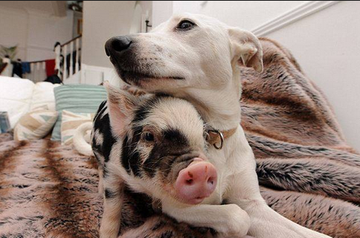
Effective? Ineffective?
Holocaust: Concentration Camps
Main idea
Evidence
Main idea
Evidence

